Slide 1
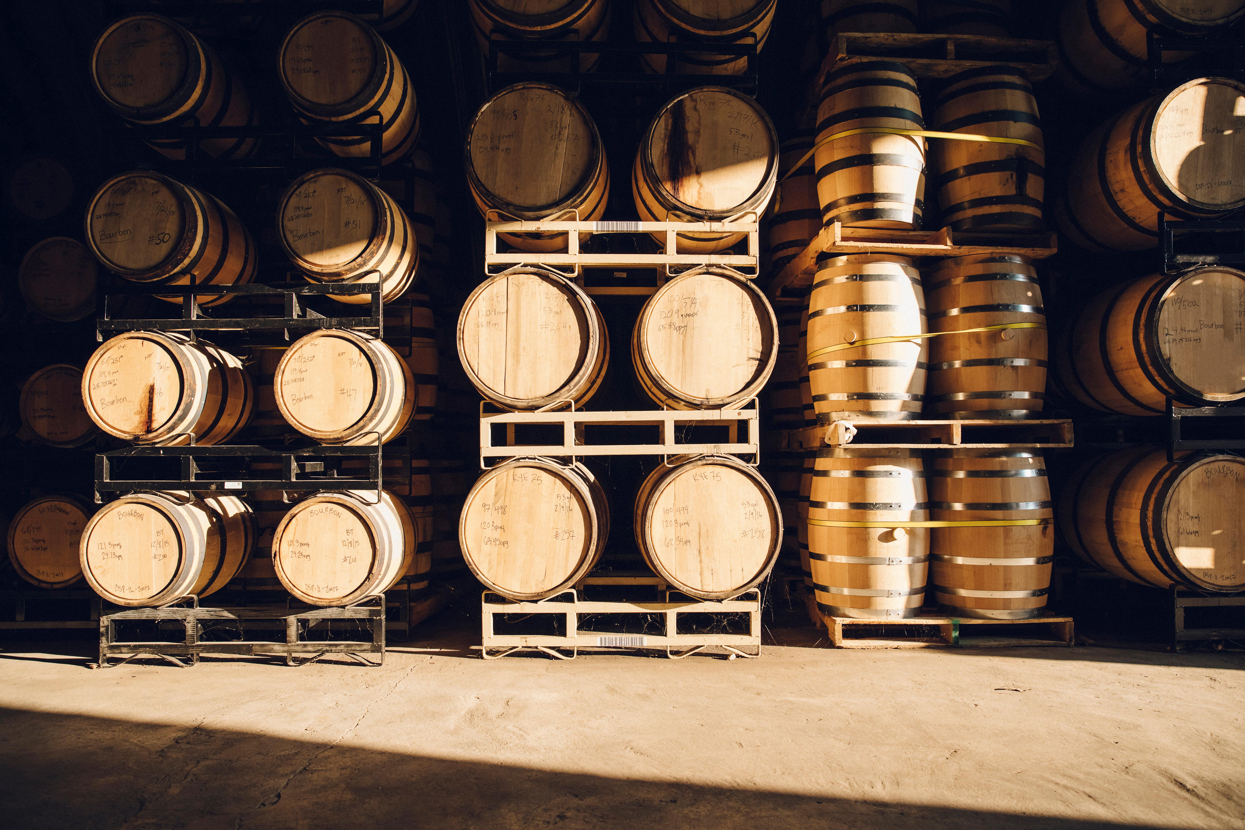
Wine quality prediction model Brianna Beyer | Denis Dragan | Summer Dowdy | Jason Hinshaw

Slide 2
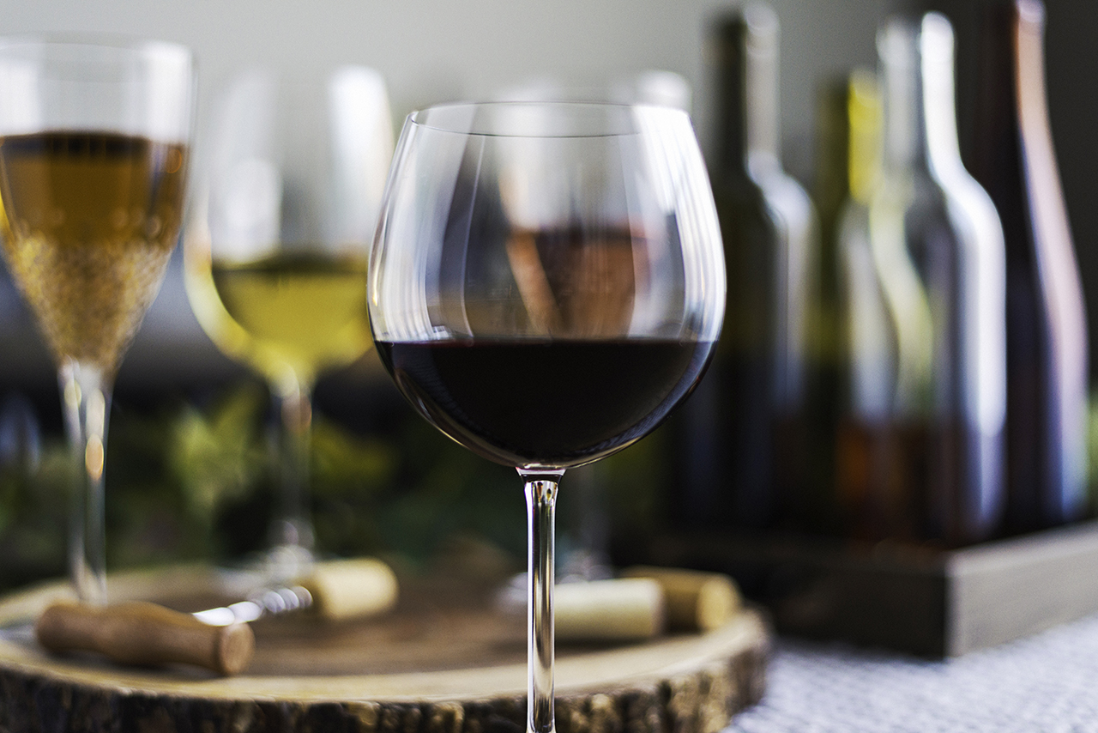
overview
Why we chose wine quality
The purpose of this project is to provide accurate wine quality predictions based on physiochemical properties using neural network and random forest models.

Slide 3

Wine 101
How is wine made?
What are the types of wine?
What are wine varietals?
What is an appellation?
What makes wine good? bad?

Slide 4
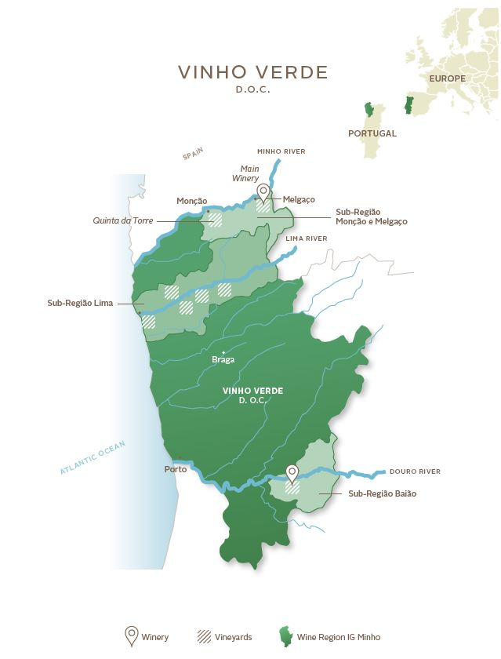
the Datasets
UC Irvine Machine Learning Repository based on data from the 2009 paper, Modeling wine preferences by data mining from physicochemical properties.
2 Datasets: Red Wine & White Wine
1,599 red data points / 4,898 data points
Data collected from Vinho Verde region in the northwest of Portugal
Each wine was analyzed, and quality assessed between 2004 and 2007 by the Viticulture Commission of the Vinho Verde Region.
Variables: 11 physiochemical properties & quality score
UC Irvine Wine Quality Datasets
Modeling Wine Preferences Paper

Slide 5
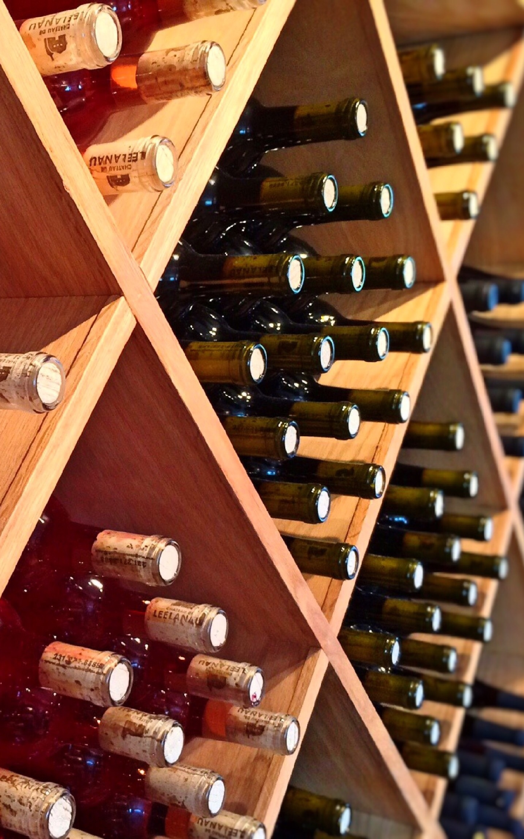
Variables
Fixed Acidity
Volatile Acidity
Citric Acid
Residual Sugar
Chlorides
Free Sulfur Dioxide
Total Sulfur Dioxide
Density
pH
Sulphates
Alcohol
Quality Score between 0 and 10
0 to 3 = Low
4 to 6 = Average
7 to 10 = High

Slide 6

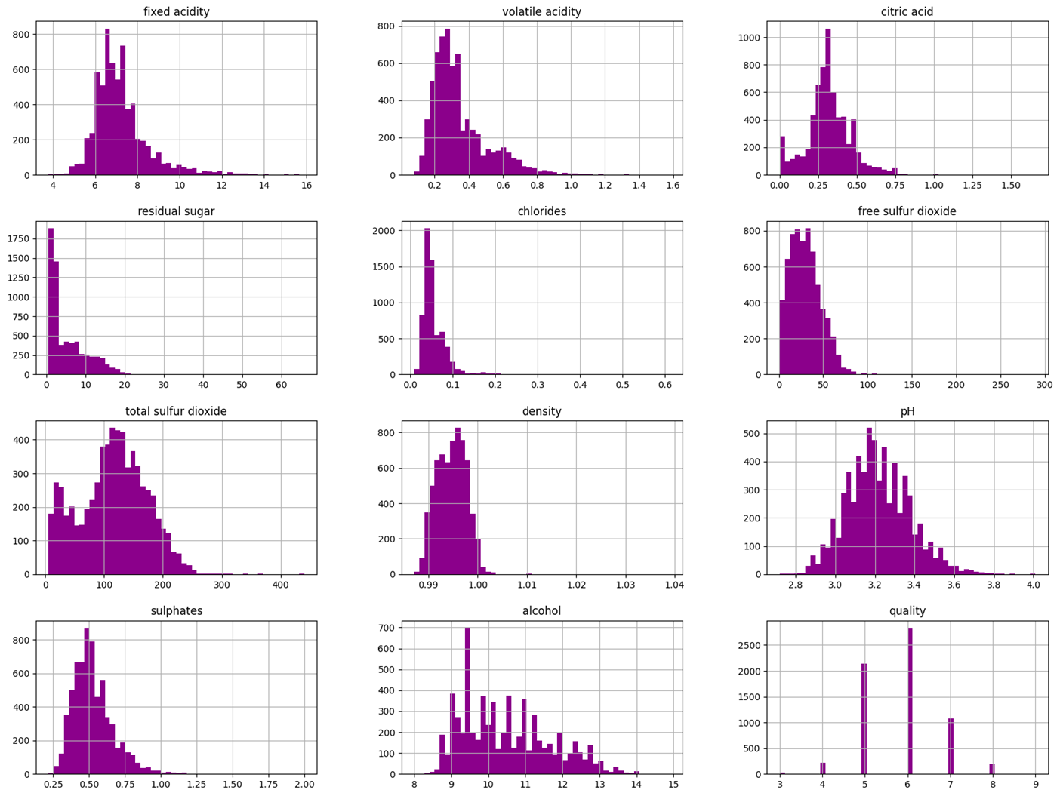
Variable histogram

Slide 7
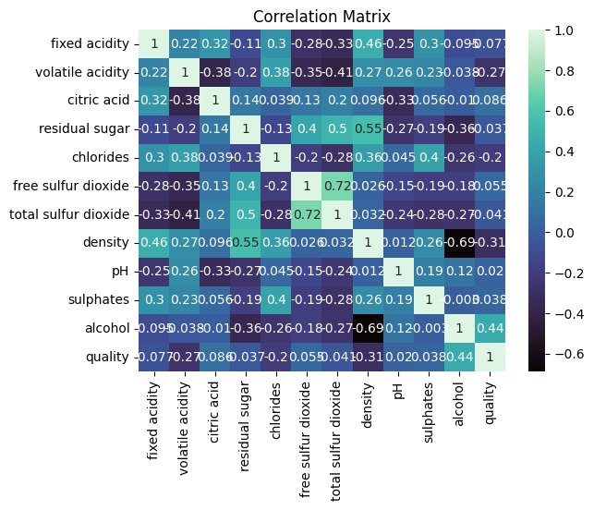
Correlation matrix

Slide 8
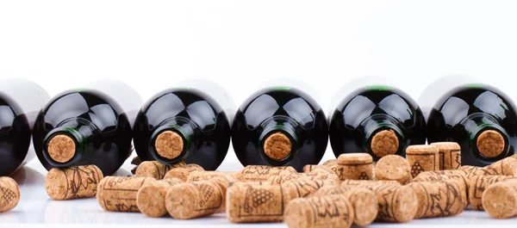
Neural Network model
Why we chose a neural network model:
Regression/classification problem
Useful when there is no clear relationship between features and output
Proficient at uncovering hidden patterns
Reliable approach to problems involving many features
Offers powerful capabilities for handling complex data
Adapts to new information

Slide 9
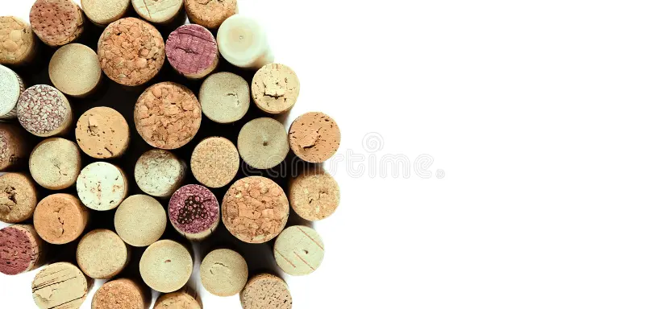
Nn Model Results
MODEL | ACCURACY | LOSS
White Wine NN | 0.820 | 0.399
Red Wine NN | 0.868 | 0.308
Combined NN *w/ Quality Category | 0.827 | 0.391
Combined NN *w/o Quality Category | 0.556 | 1.037

Slide 10

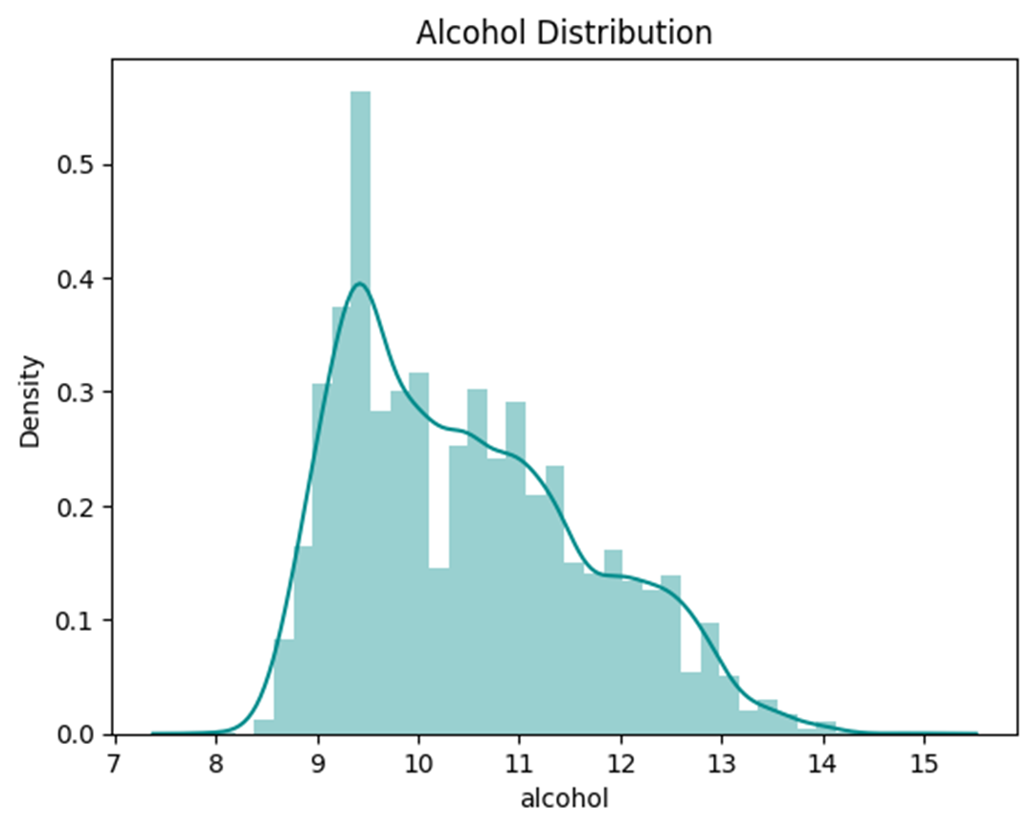
Alcohol distribution

Slide 11
Random forest model
Why we chose a random forest model:
Regression/classification problem
Offers powerful capabilities for handling complex data
Less influenced by outliers
Helpful in determining the relationship that features have with the output and the degree of influence
Reduces overfitting

Slide 12

RF classification report
INITIAL
OPTIMIZED

Slide 13
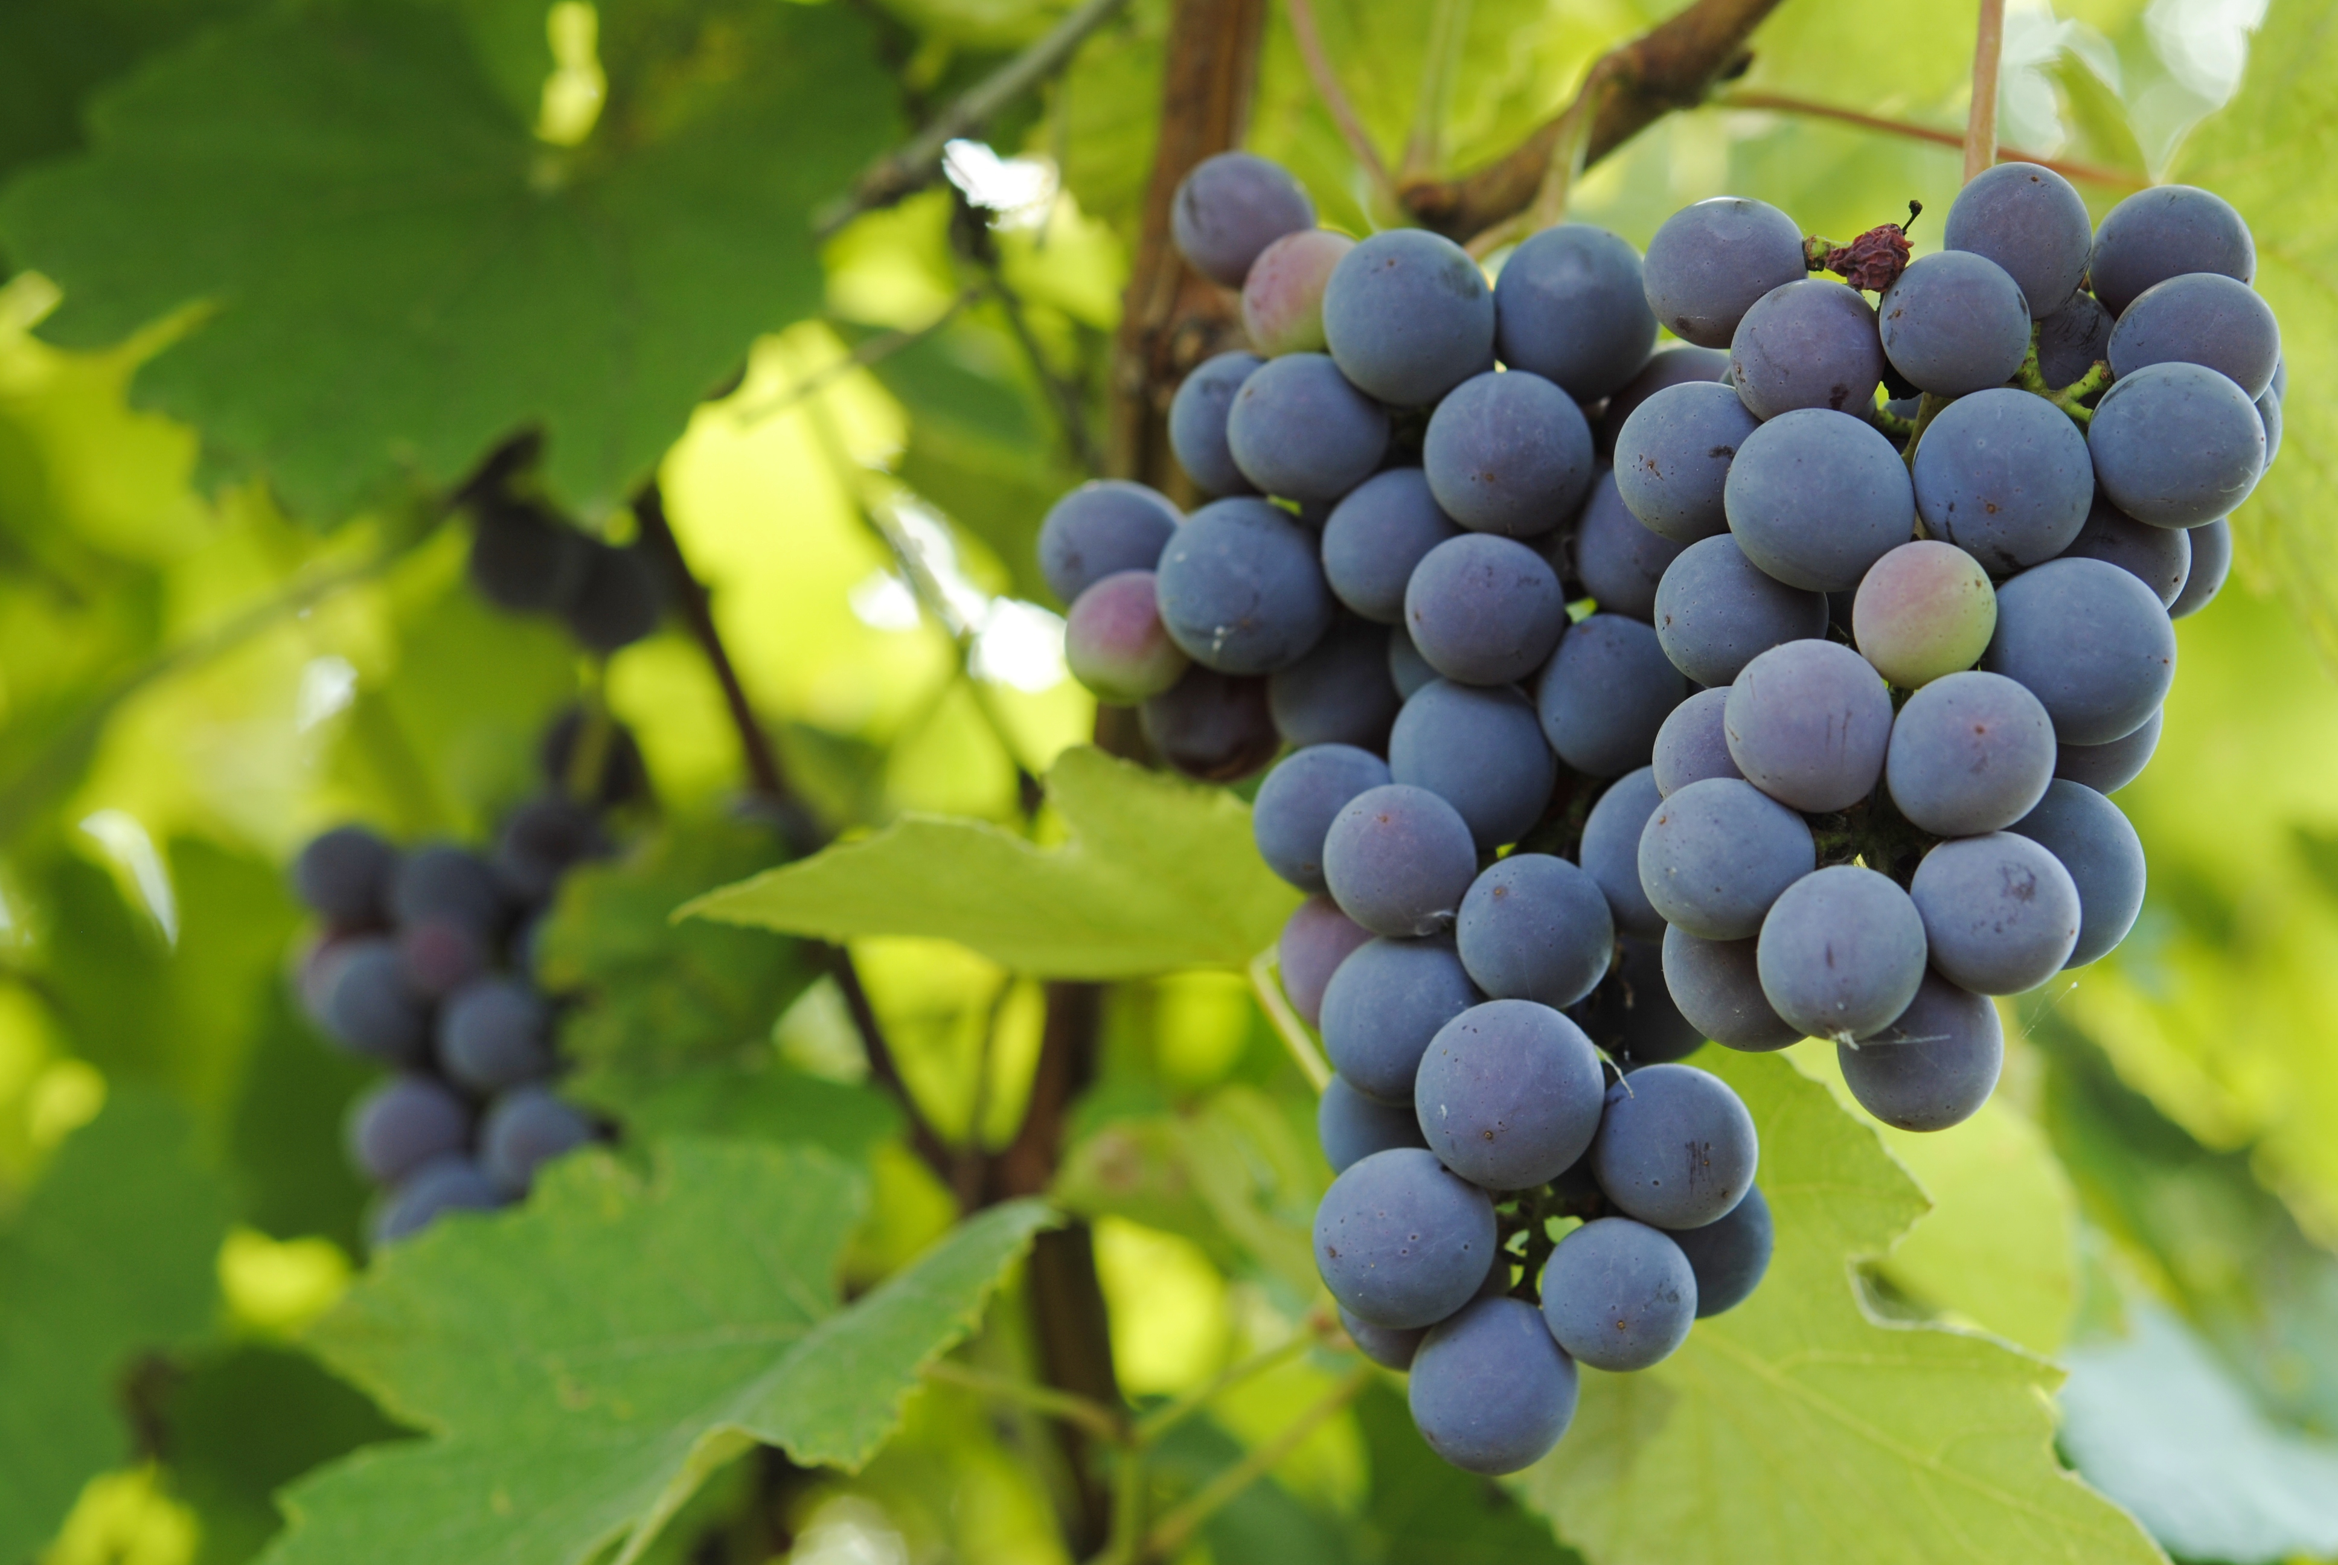
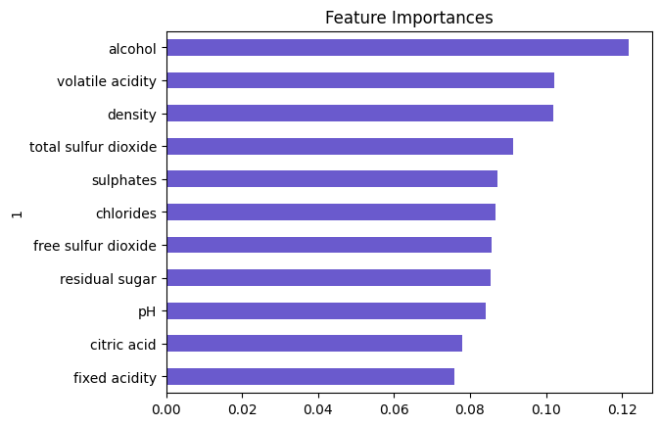
Feature importance

Slide 14
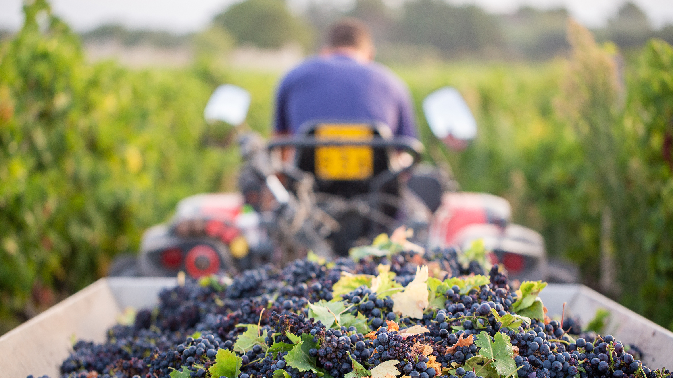
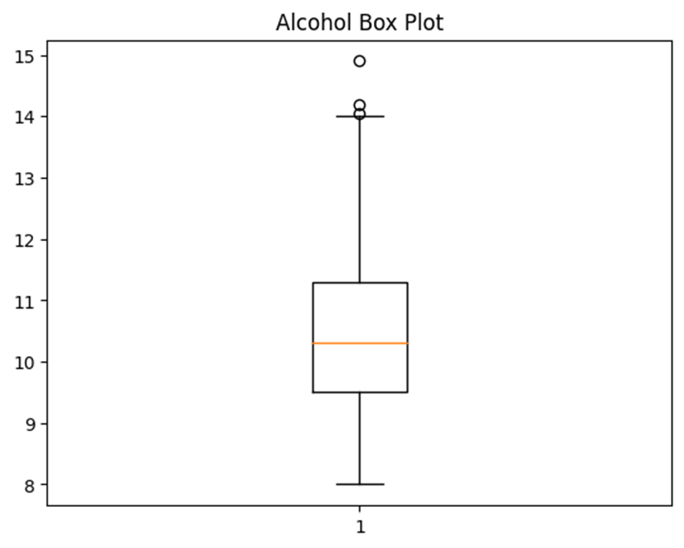
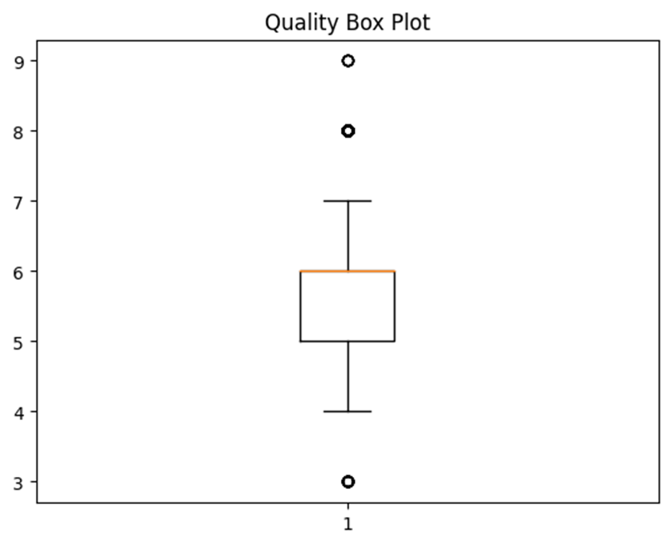
Alcohol & Quality box plots

Slide 15
rf Model Results
MODEL | ACCURACY
Combined RF *w/o RandomSampler | 0.689
Combined RF *w/ RandomSampler | 0.673

Slide 16
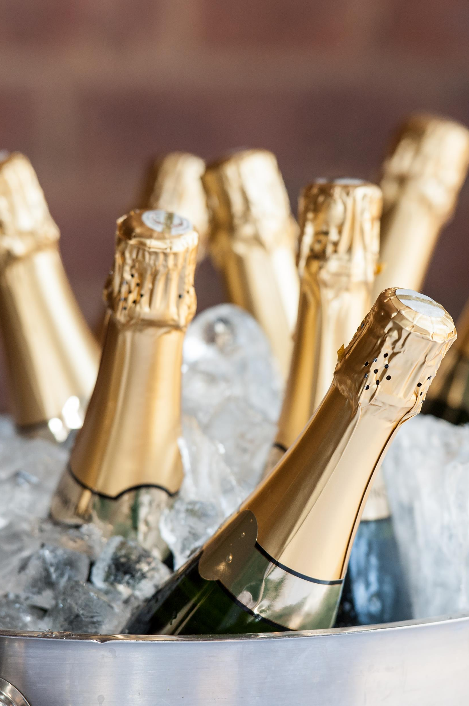
summary
Combining datasets improved the capabilities of the neural network model.
Recategorizing the quality response from 1 range to 3 separate ranges, significantly improved the capabilities of the neural network model.
The use of random sampler did not provide significant benefits in the random forest model results.
Overall, the quality category within the neural network model provided the most successful outcome.
Access to additional data would greatly improve the capabilities of both models.
Climate, altitude, location, varietal, wine brand, price point, bottle shape, and cork vs screw top are examples of additional variables that should be considered in future quality prediction models.

Slide 17
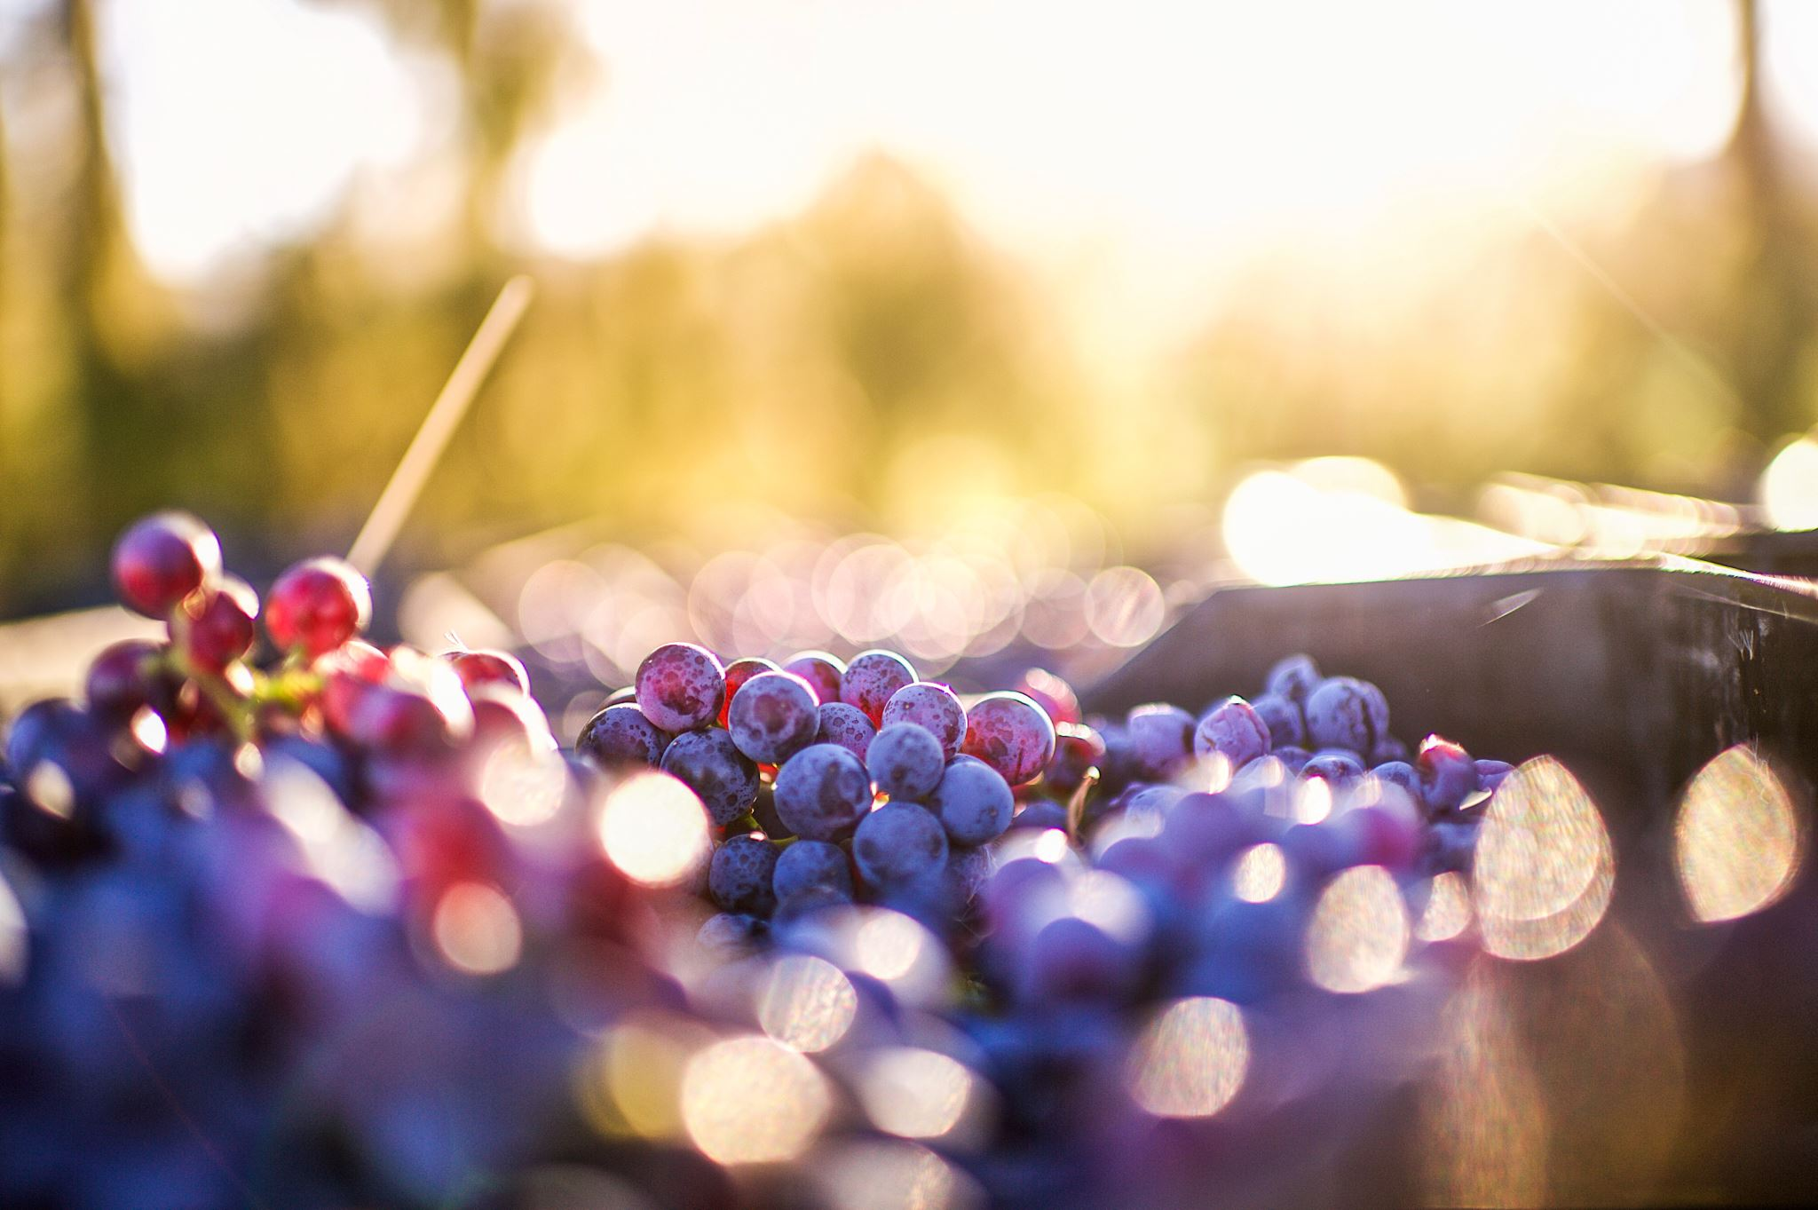
References
Cortez, Paulo, et al. “Modeling Wine Preferences by Data Mining from Physicochemical Properties.” _Decision Support Systems_, vol. 47, no. 4, Nov. 2009, pp. 547–553, https://doi.org/10.1016/j.dss.2009.05.016.
Diehm, Jan, and Lars Verspohl. “Wine & Math: A Model Pairing.” _The Pudding_, 2021, pudding.cool/2021/03/wine-model/. Accessed 5 Sept. 2024.
Parrish, Michael. “What Are Wine Varietals? Comprehensive Guide to Grape Varieties | the Tasting Alliance | the Tasting Alliance.” _The Tasting Alliance_, 14 Mar. 2024, thetastingalliance.com/what-are-wine-varietals-comprehensive-guide-to-grape-varieties/. Accessed 5 Sept. 2024.
Schull, Trista. “How Wine Is Made,” _Witches Falls Winery_, 7 Sept. 2022, witchesfalls.com.au/blogs/news/how-wine-is-made. Accessed 6 Sept. 2024.
The Wine Wankers. “A Great Collection of Wine Infographics,” _The Wine Wankers_, 12 Feb. 2014, winewankers.com/2014/02/12/a-great-collection-of-wine-infographics/. Accessed 5 Sept. 2024.
Theethat Anuraksoontorn. “Wine Quality Prediction with Python - Analytics Vidhya - Medium.” _Medium_, Analytics Vidhya, 21 Sept. 2020, medium.com/analytics-vidhya/wine-quality-prediction-with-python-695939d34d87. Accessed 5 Sept. 2024.
Wine Paths. “The Ultimate Beginners Guide to Wine.” _Www.winepaths.com_, www.winepaths.com/articles/editorial/wine-guide/the-ultimate-beginners-guide-to-wine. Accessed 5 Sept. 2024.

Slide 18
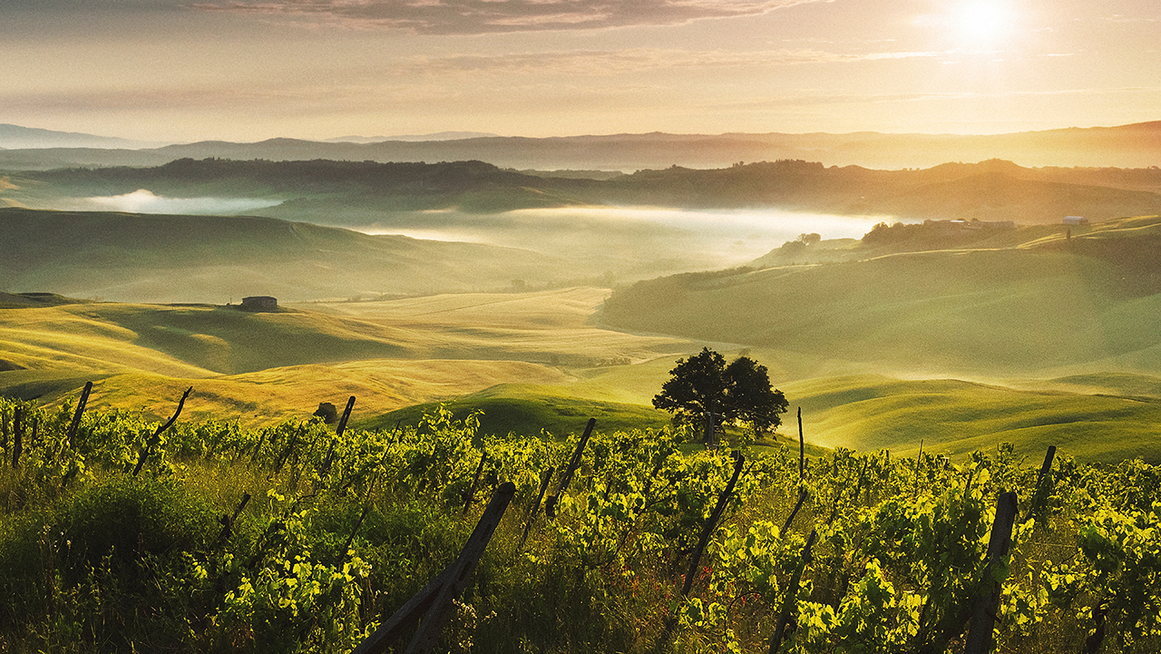
Thank you!

